Slide 1

"EduGenie AI: Your Personal Learning Companion"
Vision: "Democratizing personalized education through AI"
Mission: "Every student deserves a tutor who understands their unique learning style"
Team: NotDefined| Registration: Cyf1070 Challenge: Personalized AI Tutors

Slide 2
PROBLEM STATEMENT
"The Education Crisis Nobody Talks About"
📊 The Numbers Don't Lie:
• 65% students struggle with doubts after school hours
• 1:47 teacher-to-student ratio in average classroom
• 4 hours average homework time, 0 hours personalized help
• $300B spent globally on private tutoring (only 20% can afford) 😔 The Human Cost:
• Students give up when stuck
• Learning gaps compound over time
• One-size-fits-all teaching fails 40% of learners
• Mental health impact of academic stress

Slide 3
SOLUTION
"Meet EduGenie AI - Learning That Adapts to YOU"
🎯 What We Built:
• 24/7 AI tutor that solves doubts in <60 seconds
• Learns YOUR unique learning style
• Explains concepts in multiple ways
• Tracks progress and predicts challenges 🔧 How It Works: 1. Snap a photo of your problem 2. AI understands and analyzes 3. Get personalized explanation 4. Interactive follow-up ensures understanding

Slide 4
PRODUCT USP
"Why EduGenie AI is Different"
🌟 Our Unique Advantages:
1. "Socratic AI Method"
❌ Others: Give direct answers
✅ EduGenie: Guides students to discover solutions
2. "Multi-Modal Learning Engine"
❌ Others: Text-only explanations
✅ EduGenie: Visual + Audio + Interactive based on learning style
3. "Emotion-Aware Tutoring"
❌ Others: Same tone always
✅ EduGenie: Detects frustration, provides encouragement
4. "Knowledge Gap Radar"
❌ Others: Solve current problem only
✅ EduGenie: Identifies & fills prerequisite gaps

Slide 5
USER FLOW
"Simple as 1-2-3"
1️⃣ ONBOARDING (2 mins)
→ Quick learning style assessment
→ Subject & grade selection
→ Personalization complete!
2️⃣ DOUBT SOLVING
→ Snap/Type/Voice your question
→ AI processes in real-time
→ Multi-modal explanation
→ Verify understanding
3️⃣ CONTINUOUS LEARNING
→ Daily practice recommendations
→ Progress tracking
→ Weakness identification
→ Celebration of achievements

Slide 6
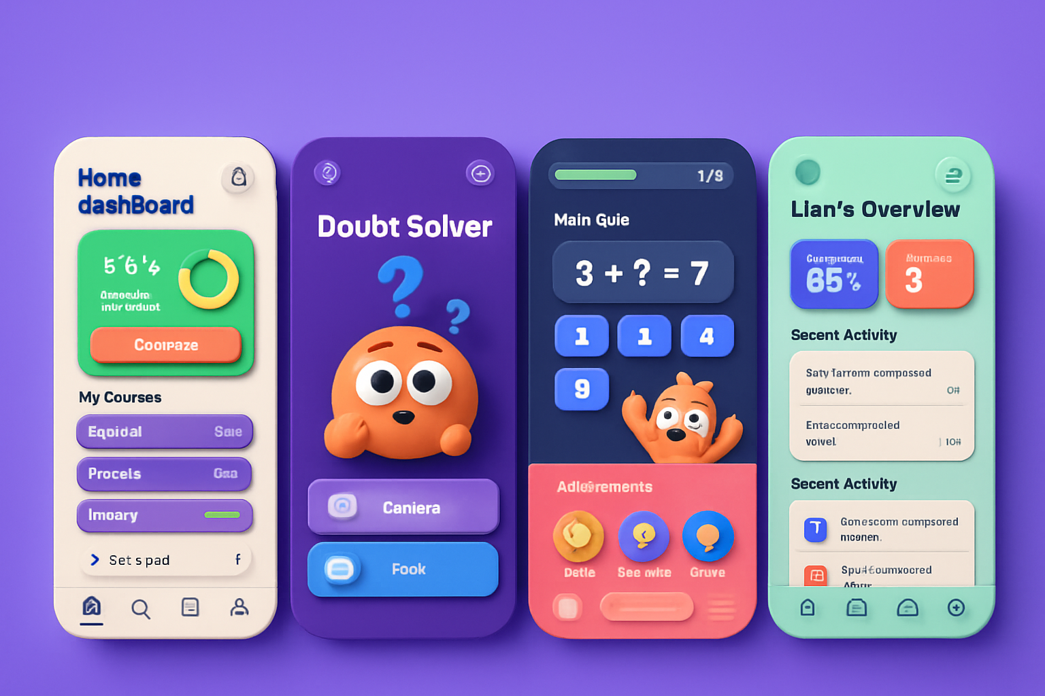
DESIGN
"Designed for Digital Natives"

Slide 7
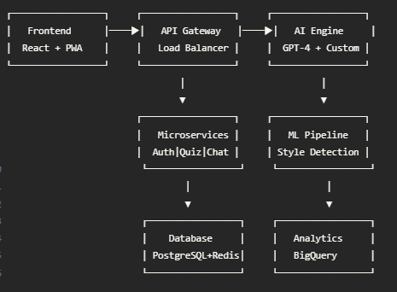
TECHNICAL ARCHITECTURE
"Built to Scale, Designed to Perform"

Slide 8
TECH STACKS
"Powered by Cutting-Edge Technology"
🎨 FRONTEND
• React 18 + Next.js (Performance)
• TailwindCSS (Responsive design)
• WebRTC (Real-time communication)
• PWA (Offline capability)
⚙️ BACKEND
• FastAPI (High performance)
• WebSocket (Real-time)
• Celery (Task queuing)
• Docker + K8s (Scalability)
🧠 AI/ML
• GPT-4 API (Natural language)
• Custom BERT model (Subject expertise)
• TensorFlow.js (Client-side ML)
• OpenCV (Image recognition)
💾 DATA
• PostgreSQL (Main database)
• Redis (Caching)
• S3 (Media storage)
• BigQuery (Analytics)

Slide 9
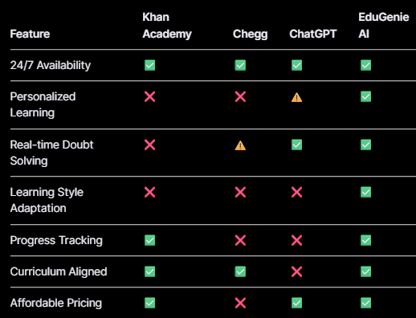
KEY COMPETITORS
"Competitive Landscape Analysis"
Our Edge: "Only platform combining AI personalization with pedagogical best practices"

Slide 10
MARKET SIZE
"Massive Market Opportunity"
🌍 GLOBAL EDTECH MARKET
• Current: $142B (2023)
• Projected: $605B (2030)
• CAGR: 20.5%
🎯 TARGET SEGMENTS
• K-12 Students: 1.5B globally
• Test Prep: $60B market
• Homework Help: $15B market
📍 INITIAL FOCUS
• India: 260M students
• US: 56M students
• SE Asia: 150M students
💰 REVENUE POTENTIAL
• B2C: $10/month × 1M users = $120M ARR • B2B: $1000/school × 10K schools = $120M ARR

Slide 11
GO-TO-MARKET PLAN
"Path to 1 Million Learners"
Phase 1: MVP Launch
• Free beta for 1000 students
• Focus: Math & Science, Grades 6-12
• Collect feedback, iterate rapidly
• Build community ambassadors
Phase 2: Growth
• Freemium launch ($0-10/month)
• Influencer partnerships
• School pilot programs (10 schools)
• SEO content strategy
Phase 3: Scale
• B2B sales team
• International expansion
• API partnerships
• White-label solutions

Slide 12
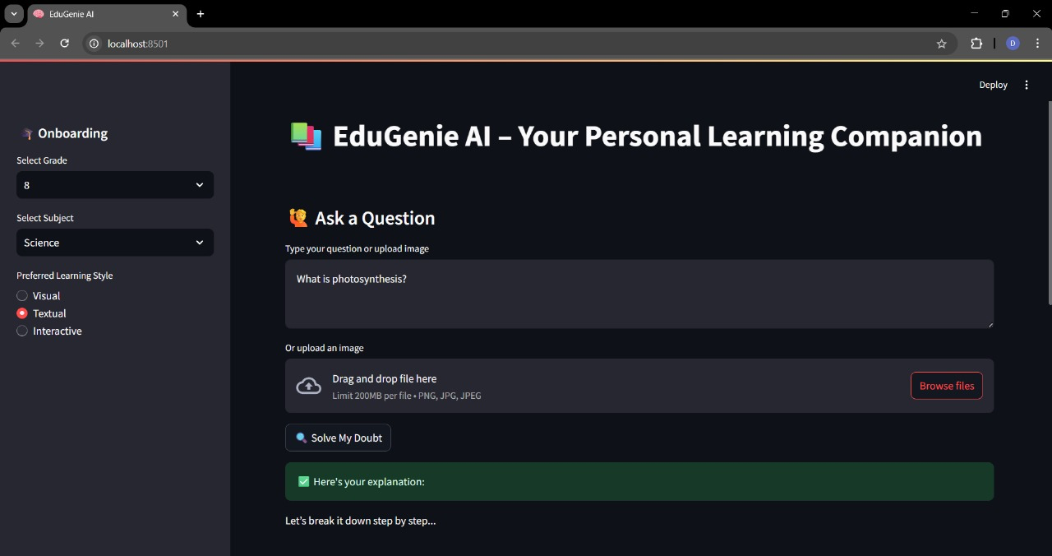
DEMO
https://drive.google.com/file/d/1UyLxoTGy6zxXNzdzhDqv3M7dcB5V3Txl/view?usp=share_link

